Slide 1
Chapter 2
The Need for security

Slide 2
Introduction
The primary mission of an information security program is to ensure that systems and their contents remain the same
Organizations expend hundreds of thousands of dollars and thousands of man-hours to maintain their information systems
Attacks on information systems are a daily occurrence, and the need for information security grows along with the sophistication of such attacks

Slide 3
Business Needs First
Information security performs four important functions for an organization:
Protecting the functionality of an organization
Enabling the safe operation of applications running on the organization’s IT systems
Protecting the data the organization collects and uses
Safeguarding the organization’s technology assets

Slide 4
Protecting the functionality of an organization
IT management are responsible for implementing security programs
organization’s communities of interest must address information security in terms of business impact and the cost of business interruption, rather than isolating security as a technical problem

Slide 5
Enable the safe operations of applications
A modern organization needs to create an environment that safeguards these applications
Enable Safe operations
important elements of the organization’s infrastructure—operating system platforms, electronic mail (e-mail), and instant messaging (IM) applications

Slide 6
Protecting the data the organization collects and uses
Without data, an organization loses its record of transactions and/or its ability to deliver value to its customers
protecting data in transmission, in processing and data at rest(storage) are critical aspects of information security

Slide 7
Safeguarding the organization’s technology assets
as an organization’s network grows to accommodate changing needs, more robust technology solutions should replace security programs the organization has outgrown
An example of a robust solution is a firewall, a mechanism that keeps certain kinds of network traffic out of a private network

Slide 8
Threats
Threat: a threat is an object, person, or other entity that presents an ongoing danger to an asset
Attack: an intentional or unintentional act that can damage or otherwise compromise information and the system that support it
Exploit: A technique used to compromise a system
Vulnerability: Weakness in system security that could exploited by a threat software flaws, weak passwords

Slide 9
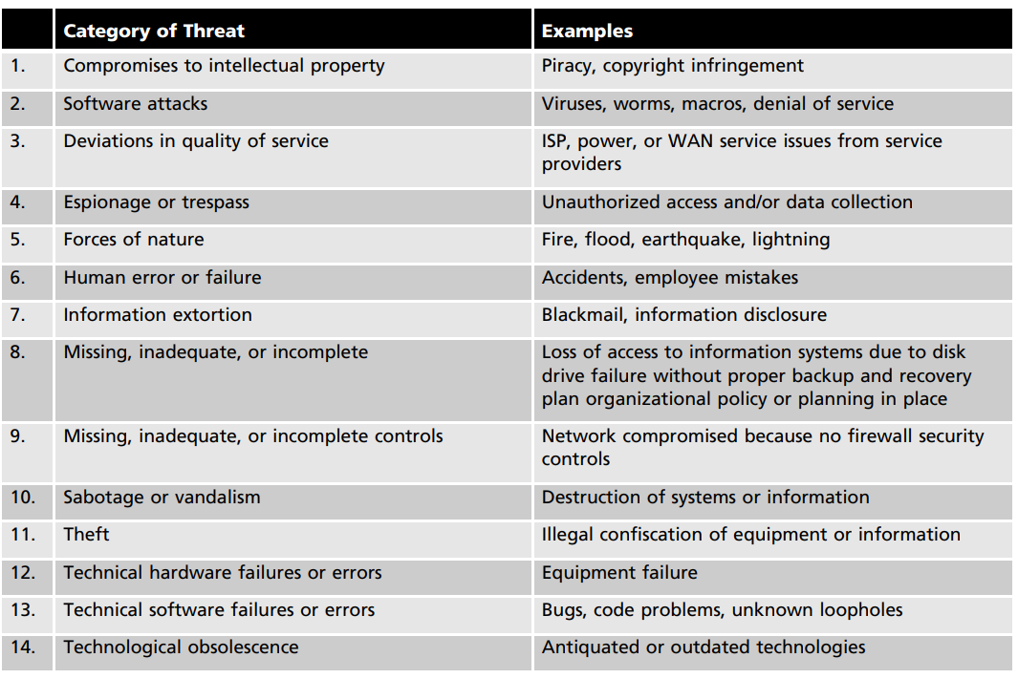
Categories of threats to IS

Slide 10
Compromises to intellectual Property
Intellectual property is defined as “the ownership of ideas and control over the tangible or virtual representation of those idea
Trade secret
Trade Mark
Patent
The most common IP breach is the unlawful use or duplication of software-based intellectual property

Slide 11
Deliberate Software attacks
Deliberate software attacks occur when an individual or group designs and deploys software to attack a system
They can damage, destroy, or deny service to the target systems. Some of the more common instances of malicious code are viruses and worms, Trojan horses, logic bombs, and back doors

Slide 12
Deliberate Software attacks
Virus
Virus: A computer virus consists of segments of code that attach itself to the application and runs whenever application runs
computer viruses are passed from machine to machine via physical media, e-mail, or other forms of computer data transmission
Modify the program functionality
Eg.Vlc media files deletion
Worms
worm is a malicious program that replicates itself constantly
Worms can continue replicating themselves until they completely fill available resources, such as memory, hard drive space, and network bandwidth
Consume computer resources and slow down your system

Slide 13
Deliberate Software attacks
Polymorphic attack
A polymorphic attack is a type of cyber attack that uses a constantly changing code, content, or structure in order to evade detection by security systems
Back Door or Trap Door
A virus or worm can have a payload that installs a back door or trap door component in a system, which allows the attacker to access the system at will with special privileges

Slide 14
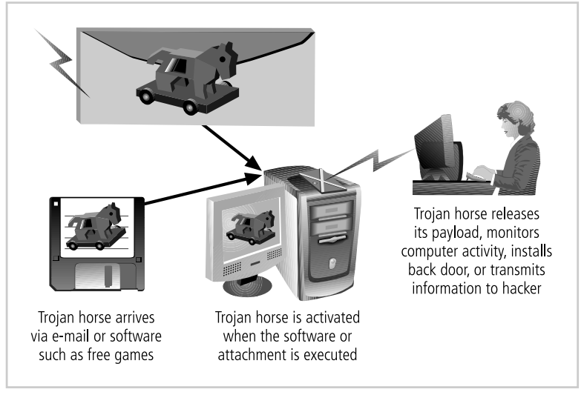
Trojan horses
Trojan horses is a type of malware that hides within a legitimate file or program to gain access to your device and leak the confidential information

Slide 15
Deviations in Quality of Service
Irregularities in Internet service, communications, and power supplies can dramatically affect the availability of information and systems
Internet Service Issues: Internet service provider failures can considerably undermine the availability of information
Web hosting provider: When a service provider fails to meet the Service Level Agreement (SLA)

Slide 16
Deviations in Quality of Service
Communications and Other Service Provider Issues Other utility services can affect organizations as well. Among these are telephone, water, wastewater, internet issues
Power Irregularities
lead to fluctuations such as power excesses, power shortages, and power losses
High voltage and low voltage severely damage or destroy equipment

Slide 17
Espionage
When an unauthorized individual gains access to the information an organization is trying to protect, that act is categorized as espionage or trespass

Slide 18
Espionage
competitive intelligence (legal)
Some information gathering techniques are quite legal, for example, using a Web browser to perform market research. These legal techniques are called, collectively, competitive intelligence
industrial espionage (illegal)
When information gatherers employ techniques that cross the threshold of what is legal or ethical, they are conducting industrial espionage. It is theft of trade secret or confidential information from a business competitor

Slide 19
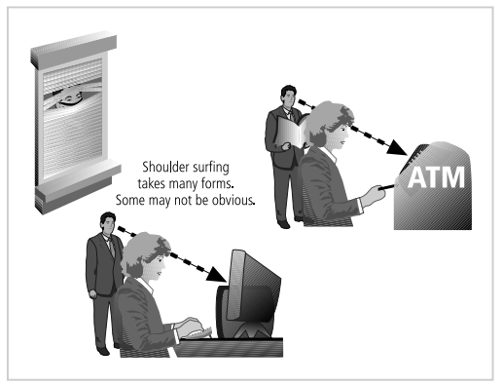
Espionage
Atm machines
PC passwords
Mobile Passwords
Website Credentials
Shoulder Surfing

Slide 20
Trespass
An attempt to use the devices without the owner's permission e.g. guess the password
Acts of trespass can lead to unauthorized real or virtual actions that enable information gatherers to enter premises or systems they have not been authorized to enter
Hackers are “people who use and create computer software to gain access to information illegally

Slide 21
Hackers
Expert Hackers
develops software scripts and program
master of programming languages, networking protocols, and operating systems
unskilled hacker
Use expertly written software to exploit a system
Do not fully understand the system they hack
Phreaker hacks the public telephone network to make free calls or disrupt services

Slide 22
Forces of Nature
Forces of nature are most dangerous threats because they are beyond the control of people
Fire
Flood
Earthquake

Slide 23
Human Error and Failure
One of the greatest threats to an organization’s information security is the organization’s own employees
inexperience
improper train
incorrect assumptions
Employee mistakes can lead to
revelation of classified data,
entry of erroneous data,
accidental deletion or modification of data,
storage of data in unprotected areas,
failure to protect information

Slide 24
Information extortion/Cyberextortion
An attacker or trusted insider steals information from a computer system and demands compensation for its return or for an agreement not to disclose it
Extortion is common in credit card number theft

Slide 25
Sabotage or Vandalism
The computer sabotage is the erasure, delete or modify without authorization functions or data of the computer system (hardware and / or software) with the intention of hindering the normal operation of the system
Purpose of sabotage or vandalism to either destroy an asset or damage the image of an organization

Slide 26
Theft
The threat of theft—the illegal taking of another’s property, which can be physical, electronic, or intellectual
Physical theft can be controlled quite easily
Electronic theft is a more complex problem to manage and control

Slide 27
Technical hardware failures or errors
manufacturer distributes equipment containing a known or unknown flaw
system perform outside of expected parameters, resulting in unreliable service or lack of availability
Some errors are terminal—that is, they result in the unrecoverable loss of the equipment
Some errors are intermittent, in that they only periodically manifest themselves, resulting in faults that are not easily repeated, and thus, equipment can sometimes stop working, or work in unexpected ways

Slide 28
Technical Software Failures or Errors
Large quantities of computer code are written, debugged, published, and sold before all their bugs are detected and resolved
combinations of certain software and hardware reveal new software bugs

Slide 29
Attack
An attack is an act that takes advantage of a vulnerability to compromise a controlled system
Attacks are intentional and their objective is to harm the organization’s information or physical asset

Slide 30
Malicious code
Malicious code is any type of code that causes harm to a computer system or network. They includes the execution of viruses, worms, Trojan horses, and active Web scripts with the intent to destroy or steal information
Spyware is a type of malicious software that is installed on a computing device without the end user's knowledge that aids in gathering information about a person or organization without their knowledge .

Slide 31
Attack
hoaxes
hoaxes are warning messages of viruses that are distributed via pop-ups, emails, and spam messages
objective of the virus hoax is to create fear and doubts in the user’s mind
Password cracking
Password cracking involves attackers trying to gain unauthorized access to systems, accounts, or files by deciphering passwords

Slide 32
Attack
Brute force
The application of computing and network resources to try every possible password combination is called a brute force attack
systematically entering every possible combination of letters, numbers, and symbols into a password field until one works
dictionary attack
The dictionary attack is a variation of the brute force attack which narrows the field by selecting specific target accounts and using a list of commonly used passwords (the dictionary) instead of random combinations.
Some users pick easy to remember passwords, like “password” or “123abc

Slide 33
Denial of services /DDOS
(DoS) attack, the attacker sends a large number of connection or information requests to a target
the target system becomes overloaded and cannot respond to legitimate requests for service
The system may crash become unable to perform ordinary functions
Distributed denial of-service (DDoS) is an attack in which a coordinated stream of requests is launched against a target from many locations at the same time

Slide 34
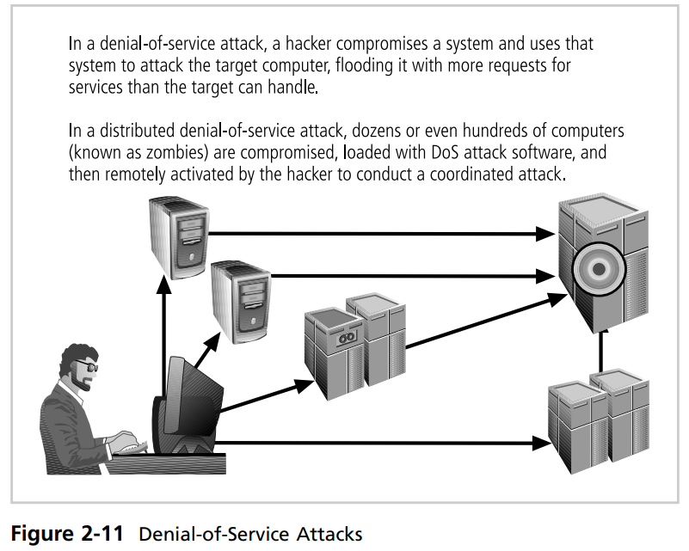
Denial of services /DDOS

Slide 35
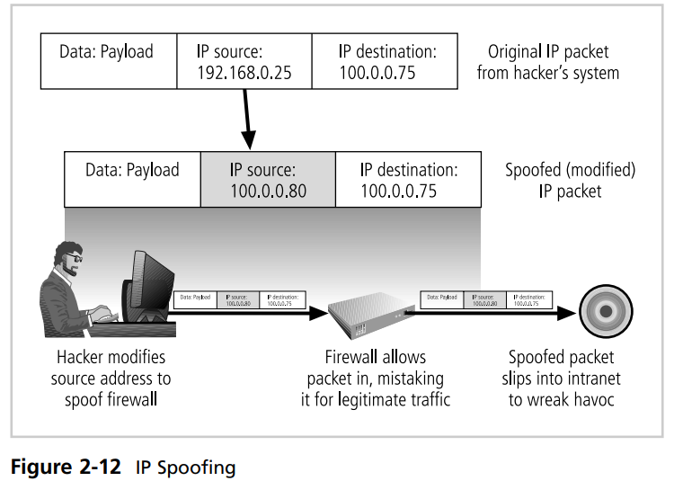
Spoofing
Spoofing is a technique used to gain unauthorized access to computers, wherein the intruder sends messages with a source IP address that has been forged to indicate that the messages are coming from a trusted host.

Slide 36
Man in the middle/ TCP hijacking
Man-in-the-middle or TCP hijacking attack, an attacker monitors (or sniffs) packets from the network, modifies them, and inserts them back into the network. This type of attack uses IP spoofing to enable an attacker to impersonate another entity on the network.
TCP hijacking, involves the interception of an encryption key exchange, which enables the hacker to act as an invisible man-in-the-middle—that is, an eavesdropper—on encrypted communications.

Slide 37
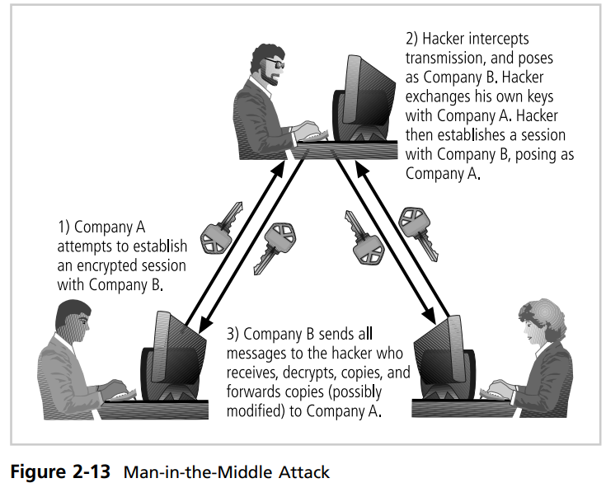
Man in the middle/ TCP hijacking

Slide 38
Attack
Spam
Spam is unsolicited commercial e-mail.
sending unwanted messages to many people, often for business or malicious reasons
use emails, texts, or instant messages
Mail Bombing
An email bomb is a denial-of-service attack that involves sending large volumes of messages to an email address. Email bombing usually aims to render the victim’s email unusable or hide important messages

Slide 39
Attack
sniffer
A sniffer is a program or device that can monitor data traveling over a network
Sniffers add risk to the network, users send information on local networks in clear text. A sniffer program shows all the data going by, including passwords, the data inside files—such as word-processing documents—and screens full of sensitive data from applications.
social engineering
social engineering is the process of using social skills to convince people to reveal access credentials or other valuable information to the attacker

Slide 40
Attack
phishing
phishing attack hackers create a counterfeit communication that looks legitimate and appears to come from a trusted source. Attackers use seemingly benign emails or text messages to trick unsuspecting users into taking an action such as downloading malware, visiting an infected site, or divulging login credentials in order to steal money or data
Pharming
Pharming is “the redirection of legitimate Web traffic (e.g., browser requests) to an illegitimate site for the purpose of obtaining private information.

Slide 41
Attack
Time Attack
A timing attack explores the contents of a Web browser’s cache and stores a malicious cookie on the client’s system. The cookie can allow the designer to collect information on how to access password-protected sites.

